Slide 1
FLIGHT PRICE PREDICTION PROJECT
By
Nishitesh Biradar

Slide 2
ABSTRACT:
Optimal timing for airline ticket purchasing from the consumer’s perspective is challenging principally because buyers have insufficient information for reasoning about future price movements. In this project we simulate various models for computing expected future prices and classifying whether this is the best time to buy the ticket.

Slide 3
INTRODUCTION:
Flight ticket prices can be something hard to guess, today we might see a price, check out the price of the same flight tomorrow, it will be a different story.
We might have often heard travelers saying that flight ticket prices are so unpredictable. As data scientists, we are goanna prove that given the right data anything can be predicted.

Slide 4
EDA Concluding:
Find patterns of data through visualization and reveal the hidden trends from data.
Using both matplotlib and seaborn library to visualize the data
Finding relationships between features using bar graphs, histograms, box plots, heatmap
Analyzing both the numerical and the categorical columns separately

Slide 5
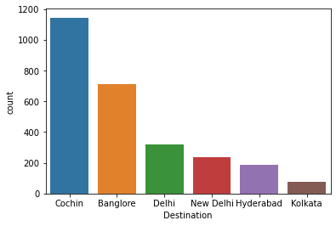
ax = sns.countplot(x="Destination",data=df_visualization_nominal)
print(df_visualization_nominal["Destination"].value_counts())

Slide 6
Data Visualization:
Data visualization is the graphical representation of information and data. By
using visual elements like charts, graphs, and maps, data visualization tools provide an
accessible way to see and understand trends, outliers, and patterns in data. In the
world of Big Data, data visualization tools and technologies are essential to analyze
massive amounts of information and make data-driven decisions.

Slide 7
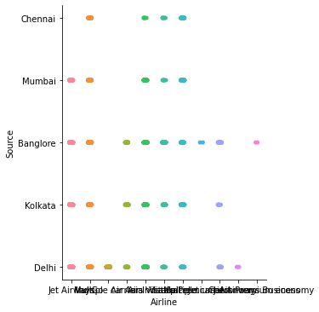
sns.catplot(x="Airline",y="Source",data=df)

Slide 8
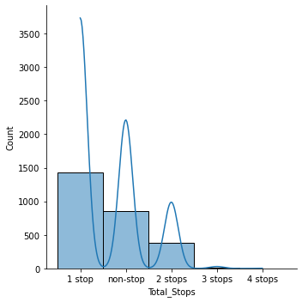
sns.displot(df_visualization_continuous['Total_Stops'], kde=True)

Slide 9
Pre-processing pipeline:
For the model to proceed with the data efficiently, the categorical variables
salary and department have been encoded. As the values of salary have an order, they have been encoded into integers within the same variable. For department, as the values have no specific order, they have been encoded into individual variables with Boolean values. Thus, the dataset has been transformed from 10variables to 19 variables. Numerical variables scaled between 0 and 1 to remove any influence of their difference in value ranges on the model. They have also been checked for skewness, without a real change on their shape.

Slide 10
Building machine learning model:
As the dataset is imbalance, use cross validation when training the models, and each baseline model performance can be tabulated.
The model will be cross-validated using a 10-fold cross validation method returning the average accuracy. This method will be applied at every modelling step, to ensure that the model is not biased by the training set split

Slide 11
According to the Regression report the accuracy of the model is 99% however positive cases. The RandomForestRegressor is providing excellent results, however the purpose of the problem is to identify employees that are likely to leave. This is the reason that recall then becomes a very important measure.
Recall measures the fraction of values that are identified correctly. Decision Tree Regression has emerged as the final
winning model with 99% and highest 99%. This could be the highest possible score achieved with the inherent limitations in the dataset

Slide 12
Machine learning models are as good as the data to feed it, and more data would strengthen the model. For example, in this dataset, the feature ‘Performance Rating’ has been restricted to scores of 3 and 4 only. More insights could be generated if the full spectrum of performance ratings is included. In the real-life situation, getting the right data is often more challenging than the analytics itself.

Slide 13
A Decision Tree is an ensemble technique capable of performing both regression and
classification tasks with the use of multiple decision trees and a technique
called Bootstrap Aggregation, commonly known as bagging
Bagging, in the Random Forest method, involves training each decision tree on a
different data sample where sampling is done with replacement.
The basic idea behind this is to combine multiple decision trees in determining the
final output rather than relying on individual Decision Tree regressor

Slide 14
CONCLUSION:
The type of recommendation engine built in this study is called content-based filtering because it uses only intrinsic and spatial features engineered for prediction. This type of recommendation needs a training set that would be too large to generate manually.
In practice, another type of recommendation engine—community-based filtering—is employed. It uses the features engineered for the properties, combined with favorite and blacklist data, to find similarity between a large number of buyers. It then pools the training set from similar buyers to create a large training set.

Slide 15
Thank You

